Slide 1
Chapter 15: User Authentication
Freshman Seminar
2022.02.11
Sumin Sohn

Slide 2
Contents
15.1 Remote user-authentication principles
15.2 Remote user-authentication using symmetric encryption
15.3 Kerberos
15.4 Remote user authentication using asymmetric encryption
15.5 Federated identity management

Slide 3
15.1 Remote User-Authentication Principles

Slide 4
User Authentication
Means of establishing the validity of the claim
Authentication process consists of 2 steps
Identification: present an identifier to the security system
Verification: present or generate authentication information
4 ways to authenticate user’s identity
Something individual knows
Something individual possesses
Something individual is (static biometrics)
Something individual does (dynamic biometrics)

Slide 5
Mutual Authentication
Enable authenticated key exchange
Communicating parties satisfy themselves mutually about each other’s identity
2 issues of authenticated key exchange
Confidentiality
For preventing masquerade or compromising
Timeliness
Important because of threat of message replay

Slide 6
Examples of Replay Attack
Simply copies a message and replays it later
Replay a timestamped message within the valid time window
Replayed message suppresses original message
Replay back to sender
Possible if symmetric encryption is used
When sender cannot easily recognize the difference between sent and received message

Slide 7
Coping with Replay Attack
Sequence number
Accepted only if its sequence number is in the proper order
Each party should keep track of the last sequence number
Because of this overhead, not used for authentication and key exchange
Timestamps
A accepts a message as fresh only
Fresh = close enough to A’s knowledge of current time
Challenge/response
A first sends a nonce(challenge) to B
Requires message(response) contain correct nonce value

Slide 8
One-Way Authentication
Required when sender and receiver are not in communication at same time
E.g., email
Requirements for e-mail protocol
Header must be in clear
Can be handled by store-and-forward protocol
Contents may be encrypted
Mail-handling protocol should not require access to the plaintext form of the message
Encrypted such that the mail-handling system is not in possession of the decryption key
Require trusting the mail-handling mechanism
Recipient wants to assure message is from alleged sender

Slide 9
15.2 Remote User-Authentication Using Symmetric Encryption

Slide 10
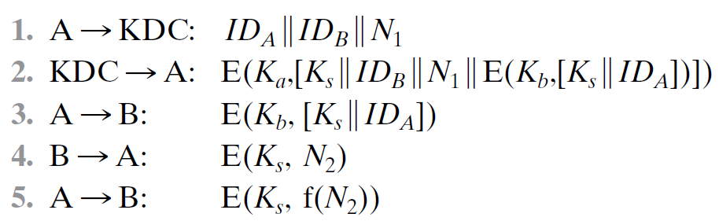
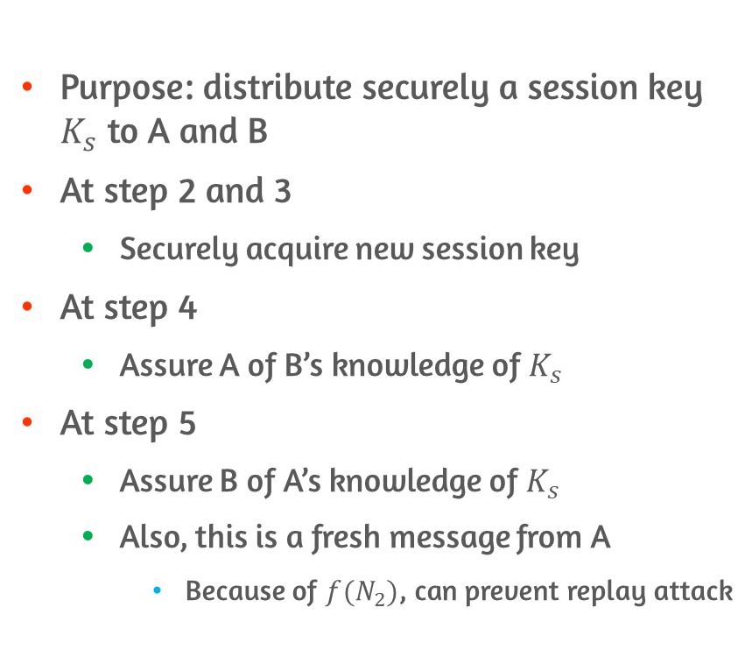
Secret Key Distribution Using a KDC
Purpose: distribute securely a session key $K_{s}$ to A and B
At step 2 and 3
Securely acquire new session key
At step 4
Assure A of B’s knowledge of $K_{s}$
At step 5
Assure B of A’s knowledge of $K_{s}$
Also, this is a fresh message from A
Because of $f(N_{2})$, can prevent replay attack

Slide 11
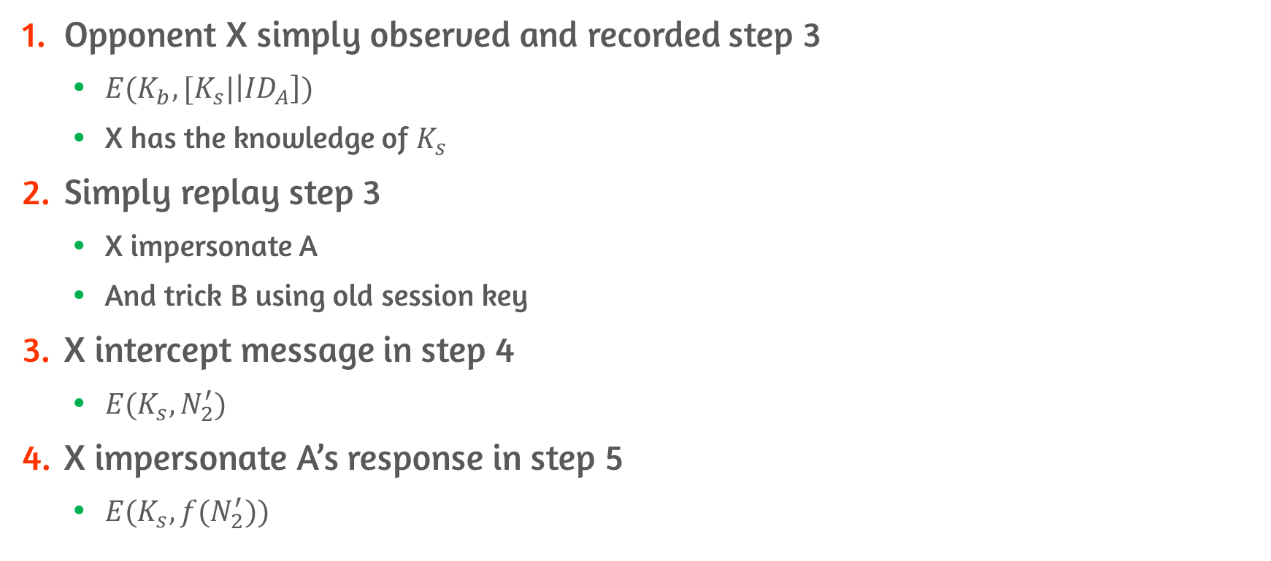
Attack: Compromise Old Session Key
Opponent X simply observed and recorded step 3
$E(K_{b}, [K_{s}|\left|{ID}_{A}\right])$
X has the knowledge of $K_{s}$
Simply replay step 3
X impersonate A
And trick B using old session key
X intercept message in step 4
$E(K_{s}, N_{2}^{′})$
X impersonate A’s response in step 5
$E(K_{s}, {f(N}_{2}^{′}))$

Slide 12
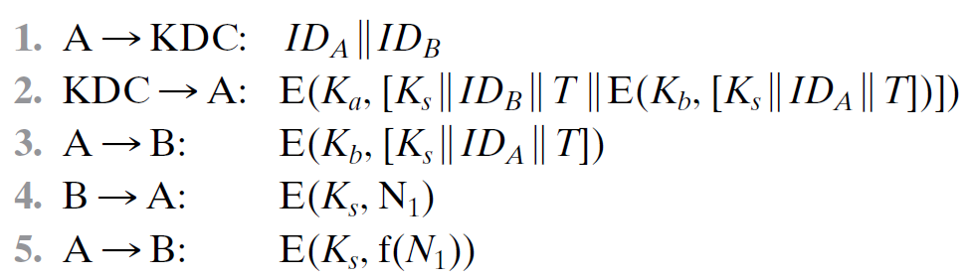
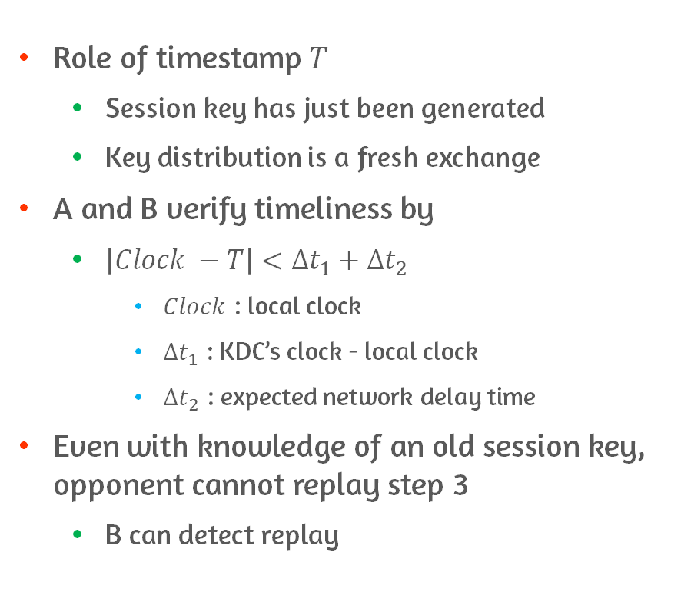
Addition of Timestamp to Step 2 and 3
Role of timestamp $T$
Session key has just been generated
Key distribution is a fresh exchange
A and B verify timeliness by
$\left|Clock −T\right|<Δt_{1}+Δt_{2}$
$Clock$ : local clock
$Δt_{1}$ : KDC’s clock - local clock
$Δt_{2}$ : expected network delay time
Even with knowledge of an old session key, opponent cannot replay step 3
B can detect replay

Slide 13
Attack: Suppress-Replay Attack
However, reliance on clocks that are synchronized throughout network is required
Distributed clocks can become unsynchronized
Faults in clock
Synchronization mechanism problem
Problem occurs when a sender’s clock is ahead of intended recipient’s site
Opponent intercept a message from sender
Replay it later
When timestamp in message becomes current at recipient’s site

Slide 14
Counter Suppress-Replay Attack
Parties regularly check clocks against KDC’s clock
Rely on handshaking protocols using nonce
Avoid need for clock synchronization
Nonce are unpredictable to the sender
Because recipient choose nonce in the future
Not vulnerable to suppress attack

Slide 15
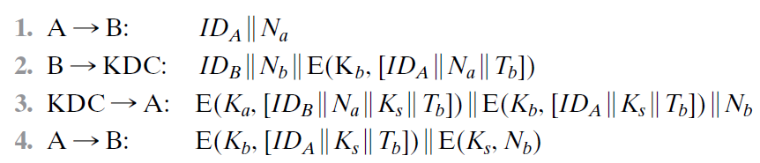
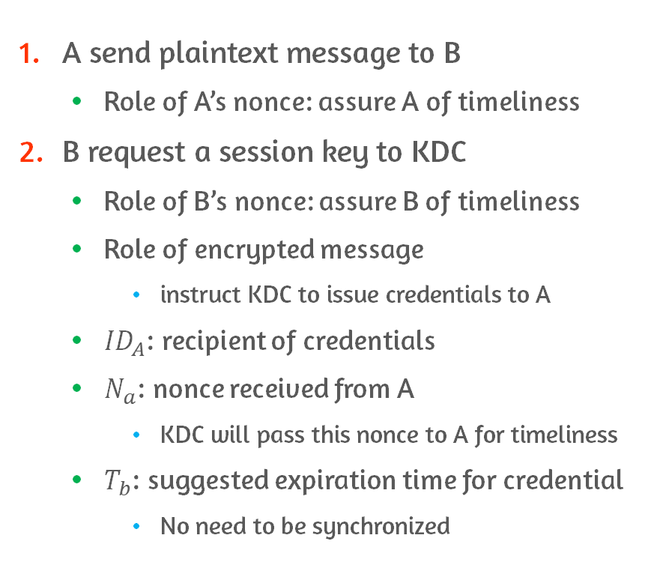
Fix on Secret Key Distribution Using KDC #1
A send plaintext message to B
Role of A’s nonce: assure A of timeliness
B request a session key to KDC
Role of B’s nonce: assure B of timeliness
Role of encrypted message
instruct KDC to issue credentials to A
${ID}_{A}$: recipient of credentials
$N_{a}$: nonce received from A
KDC will pass this nonce to A for timeliness
$T_{b}$: suggested expiration time for credential
No need to be synchronized

Slide 16
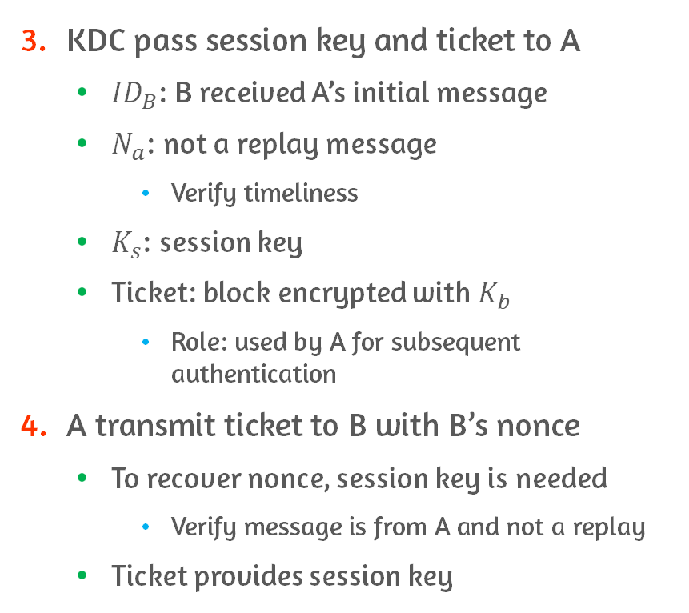
Fix on Secret Key Distribution Using KDC #2
KDC pass session key and ticket to A
${ID}_{B}$: B received A’s initial message
$N_{a}$: not a replay message
Verify timeliness
$K_{s}$: session key
Ticket: block encrypted with $K_{b}$
Role: used by A for subsequent authentication
A transmit ticket to B with B’s nonce
To recover nonce, session key is needed
Verify message is from A and not a replay
Ticket provides session key

Slide 17
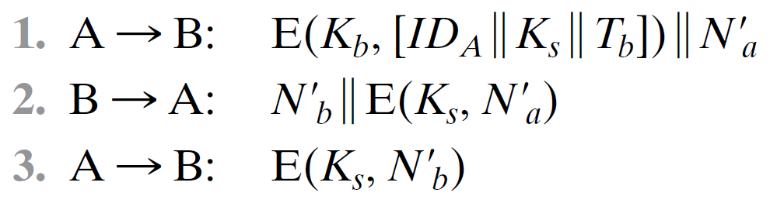
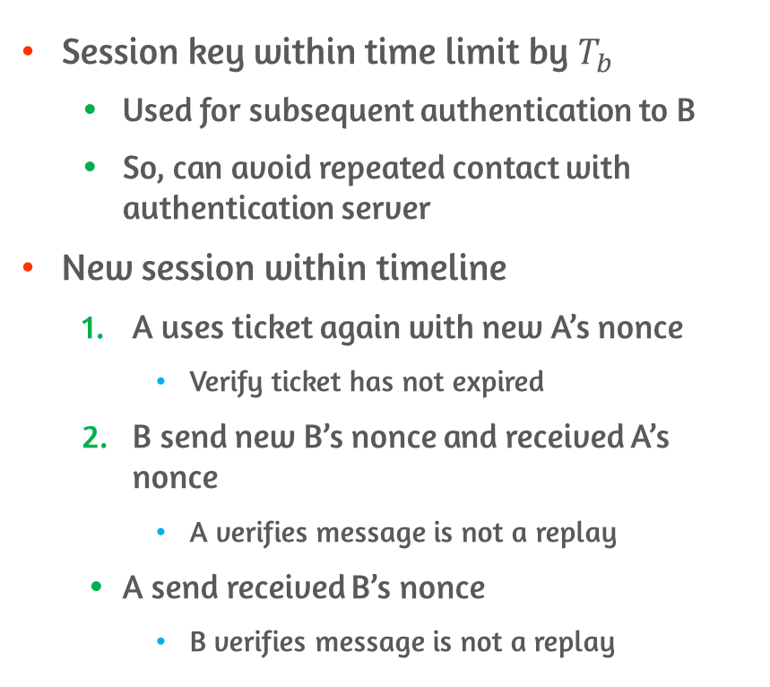
Fix on Secret Key Distribution Using KDC #3
Session key within time limit by $T_{b}$
Used for subsequent authentication to B
So, can avoid repeated contact with authentication server
New session within timeline
A uses ticket again with new A’s nonce
Verify ticket has not expired
B send new B’s nonce and received A’s nonce
A verifies message is not a replay
A send received B’s nonce
B verifies message is not a replay

Slide 18
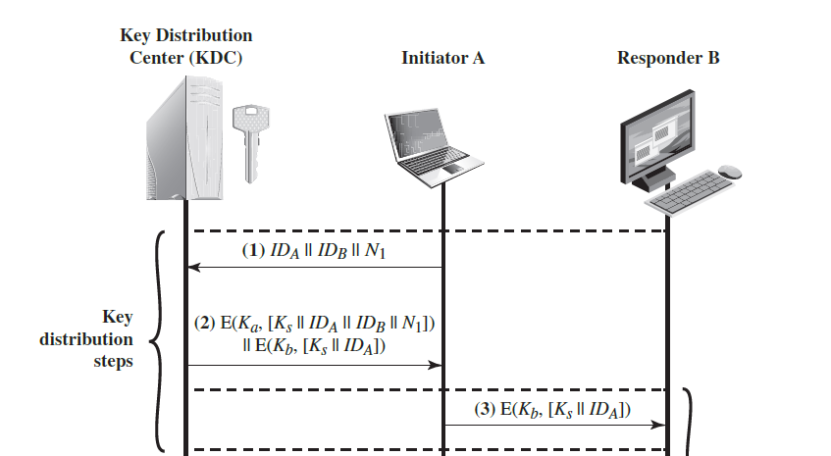
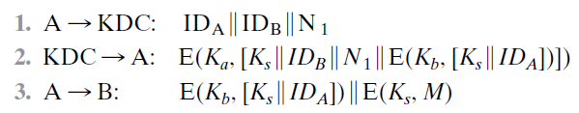
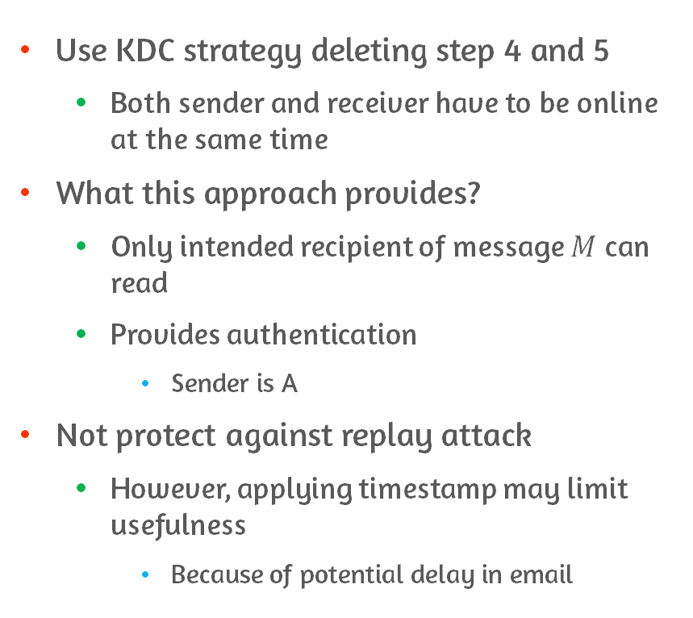
Refinement on KDC Strategy
Use KDC strategy deleting step 4 and 5
Both sender and receiver have to be online at the same time
What this approach provides?
Only intended recipient of message $M$ can read
Provides authentication
Sender is A
Not protect against replay attack
However, applying timestamp may limit usefulness
Because of potential delay in email

Slide 19
15.3 Kerberos

Slide 20
Possible Threats
Open distributed environment
Users at workstations want to access services on servers distributed throughout network
Servers want
Restrict access to authorized users
Authenticate requests for service
Threats on this environment
User gain access to a particular workstation and pretend to be another user
User may alter the network address of a workstation
Requests appear to come from impersonated workstation
User eavesdrop on exchanges and use replay attack to access or disrupt to server
Kerberos can handle these threats

Slide 21
Motivation
Distributed architecture
Consist of dedicated user workstations(client) and distributed or centralized servers
Approaches
Rely on each individual client workstation to assure the identity of its users
Require that client systems authenticate themselves to servers
Require user to prove his or her identity for each service
Also, require that servers prove their identity to clients
Needed to protect resources in open environment
Kerberos supports this approach
Notes:
여기서 내용의 핵심이 뭔지?
Prove 와 authenticate의 차이?

Slide 22
Requirements on Kerberos
Secure
Eavesdropper cannot obtain information to impersonate user
Opponent does not find it to be the weak link on Kerberos
Reliable
Lack of availability of Kerberos service = lack of availability of the supported services
Hence, Kerberos should be reliable and employ distributed server architecture
Transparent
User should not be aware that authentication is taking place beyond entering password
Scalable
System support large numbers of clients and servers

Slide 23
Simple Authentication Dialogue #1
Problem
In unprotected network environment, any client can apply to any server for service
Risk: impersonation
Obtain privileges on server
Counter
Each server is required to confirm identities of clients who request service
Burden on each server
Use authentication server(AS)
Knows the passwords of all users and stores these in centralized database
Share a unique secret key with each server

Slide 24
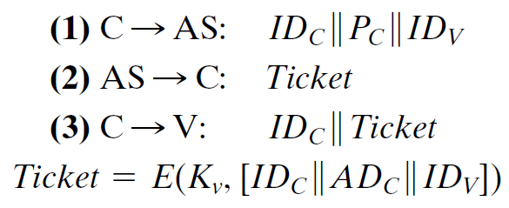
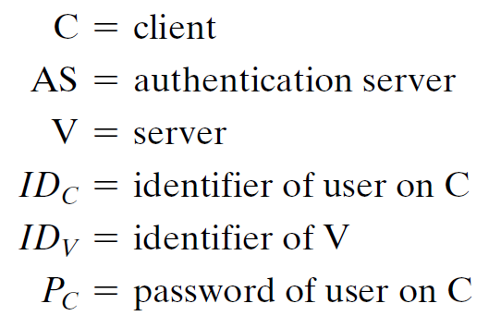
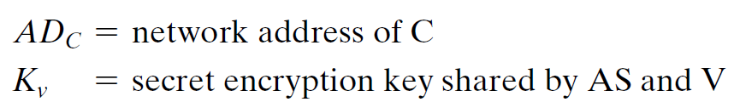
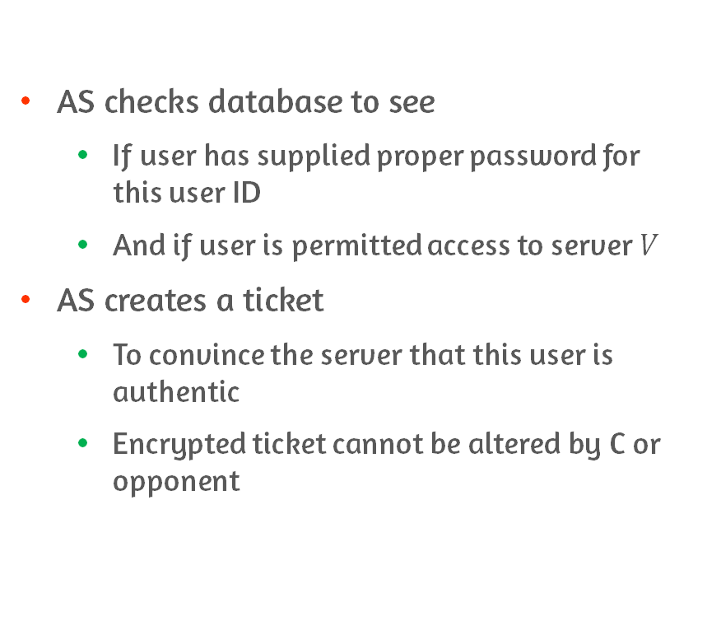
Simple Authentication Dialogue #2
AS checks database to see
If user has supplied proper password for this user ID
And if user is permitted access to server $V$
AS creates a ticket
To convince the server that this user is authentic
Encrypted ticket cannot be altered by C or opponent

Slide 25
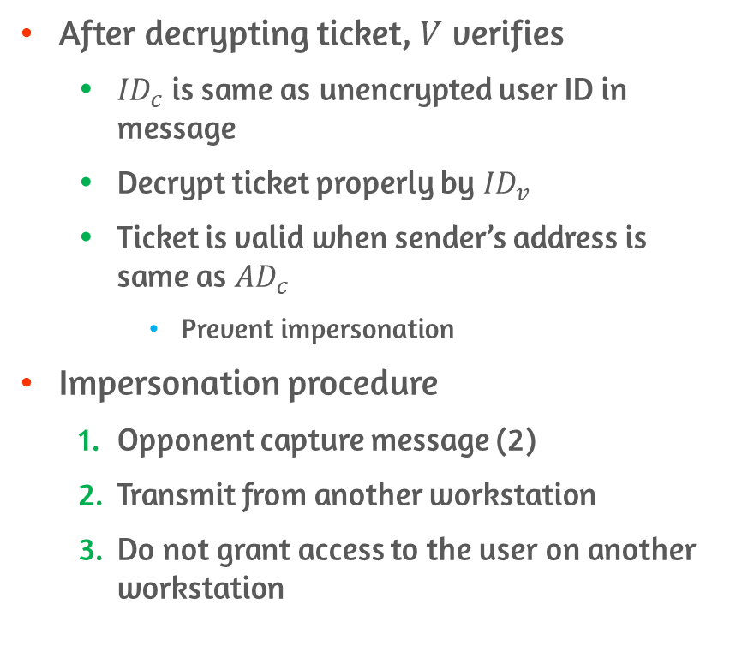
Simple Authentication Dialogue #3
After decrypting ticket, $V$ verifies
${ID}_{c}$ is same as unencrypted user ID in message
Decrypt ticket properly by ${ID}_{v}$
Ticket is valid when sender’s address is same as ${AD}_{c}$
Prevent impersonation
Impersonation procedure
Opponent capture message (2)
Transmit from another workstation
Do not grant access to the user on another workstation

Slide 26
Have 2 Problems
Want to minimize number of times to enter password
Improve matters by reusable tickets
For a single logon session, workstation can store ticket and use for multiple accesses
However, still need a new ticket for every different service
E.g., print server, mail server, file server, etc.
Involve plaintext transmission of password
Eavesdropper can capture password and use for any service

Slide 27
How to Solve?
Introduce a scheme
New server Ticket-granting Server(TGS)
To minimize number of entering password
Avoid plaintext password
Role of each server
User request ticket-granting ticket from AS
Each time user requires access to a new service, Client applies to TGS using ticket
Use ticket-granting ticket to authenticate its user
TGS issues tickets to users who have been authenticated to AS

Slide 28
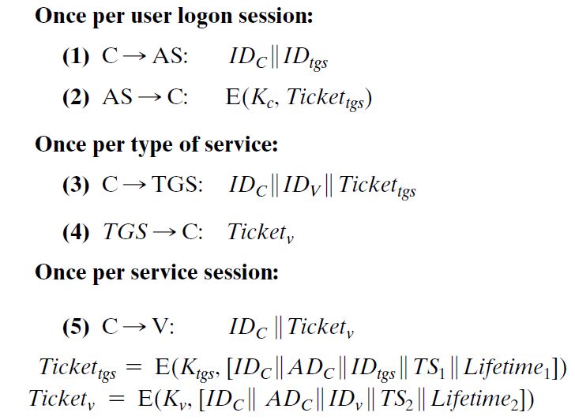
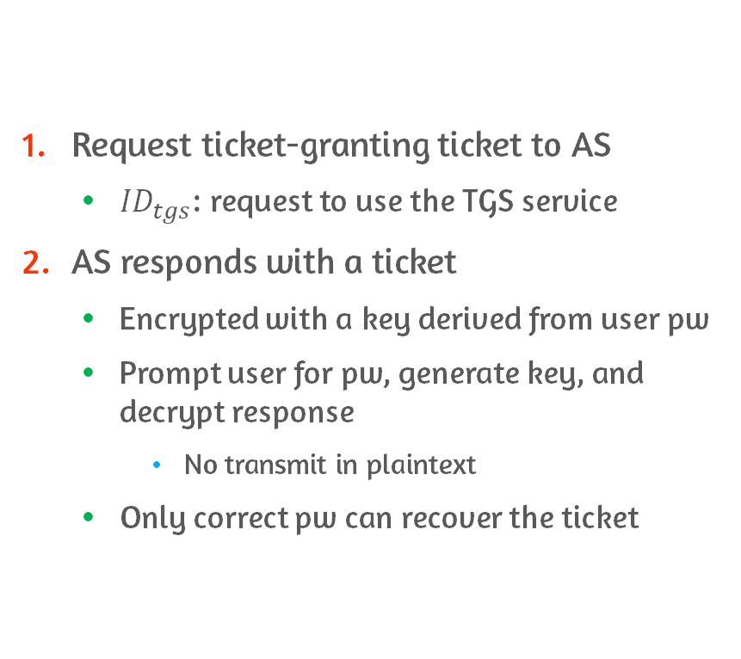
More Secure Authentication Dialogue #1
Request ticket-granting ticket to AS
${ID}_{tgs}$: request to use the TGS service
AS responds with a ticket
Encrypted with a key derived from user pw
Prompt user for pw, generate key, and decrypt response
No transmit in plaintext
Only correct pw can recover the ticket

Slide 29
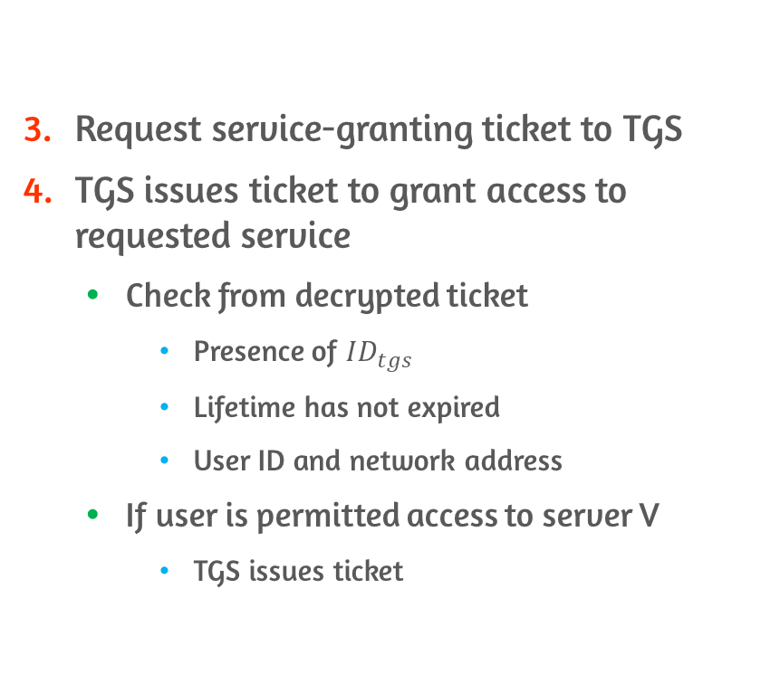
More Secure Authentication Dialogue #2
Request service-granting ticket to TGS
TGS issues ticket to grant access to requested service
Check from decrypted ticket
Presence of ${ID}_{tgs}$
Lifetime has not expired
User ID and network address
If user is permitted access to server V
TGS issues ticket

Slide 30
More Secure Authentication Dialogue #3
Request access to service
Server authenticates by contents of ticket

Slide 31
Still Have 2 Problems
Lifetime associated with ticket-granting ticket
If short, user repeatedly enter password
If long, opponent has greater opportunity for replay
Capture a copy of ticket-granting ticket and send to TGS
And unlimitedly access to resources and files
Same problem with capturing service-granting ticket
Additional requirement: TGS and service must prove “ticket presenter = ticket issued person”
Requirement for servers to authenticate themselves to user
False server may act as a real server
And capture information from user and deny true service
Notes:
Ticket granting ticket을 캡처해
사용자가 로그아웃 하면, 사용자 네트워크 주소로 TGS에 접근

Slide 32
How to Solve?
Problem of captured ticket-granting tickets
Threat: steal the ticket and use before it expires
Need to determine presenter and issued person are same
AS provide both client and TGS with session key in secure manner
Client can prove its identity to TGS by revealing secret information

Slide 33
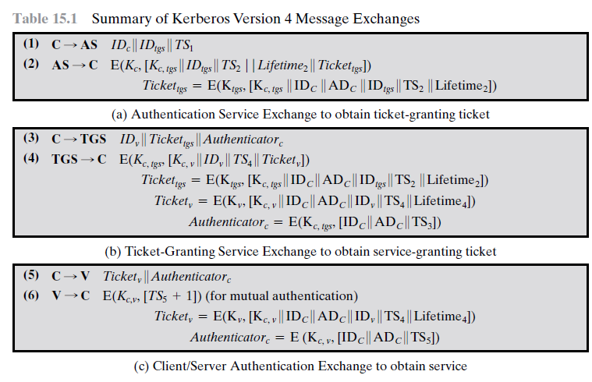
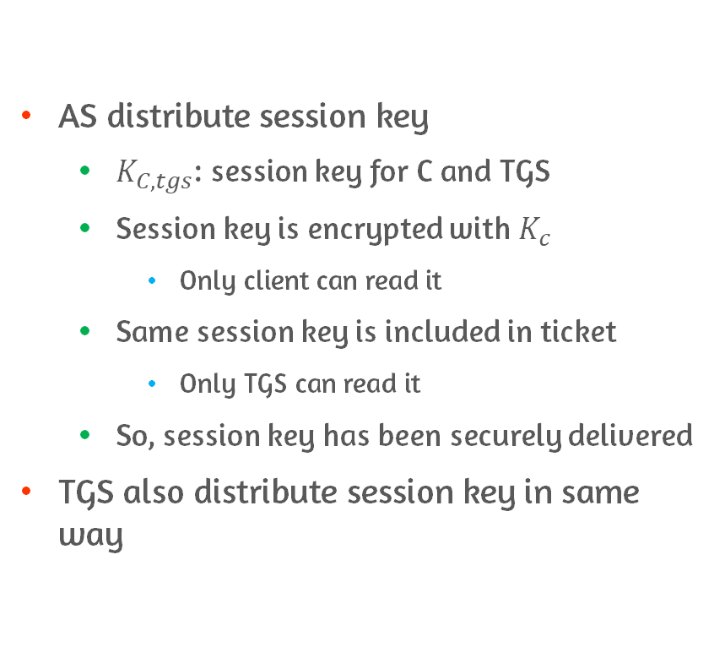
Solution in Kerberos Version 4 #1
AS distribute session key
$K_{C, tgs}$: session key for C and TGS
Session key is encrypted with $K_{c}$
Only client can read it
Same session key is included in ticket
Only TGS can read it
So, session key has been securely delivered
TGS also distribute session key in same way

Slide 34
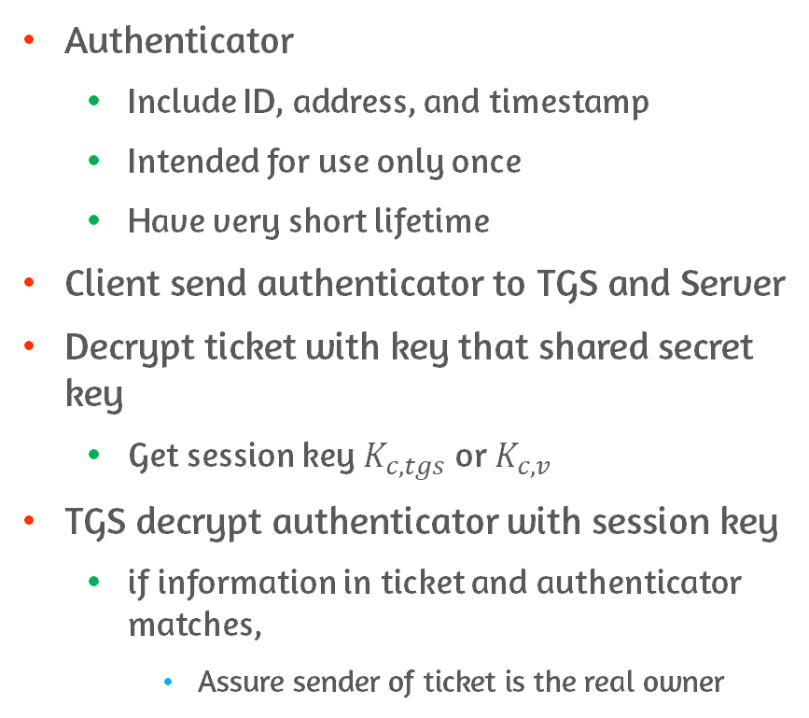
Solution in Kerberos Version 4 #2
Authenticator
Include ID, address, and timestamp
Intended for use only once
Have very short lifetime
Client send authenticator to TGS and Server
Decrypt ticket with key that shared secret key
Get session key $K_{c, tgs}$ or $K_{c, v}$
TGS decrypt authenticator with session key
if information in ticket and authenticator matches,
Assure sender of ticket is the real owner
Notes:
Ticket = not prove anyone’s identity & distribute session key securely
Authenticator = prove client’s identity
Used only once
Has short lifetime
이 두가지 특성 때문에 stealing both ticket and authenticator for presentation later 에 대한 위협은 is countered(대응됨)

Slide 35
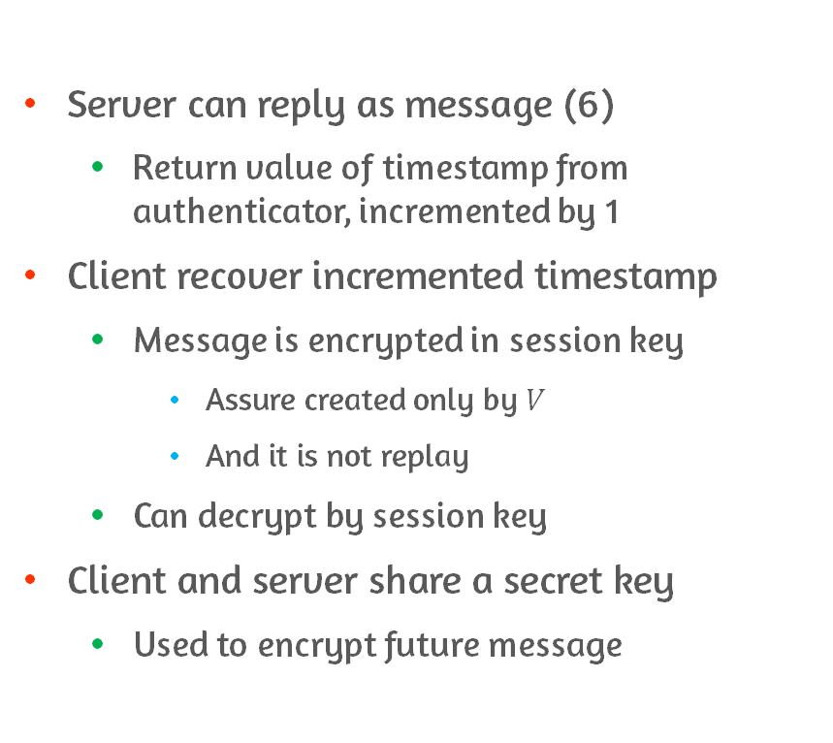
Mutual Authentication
Server can reply as message (6)
Return value of timestamp from authenticator, incremented by 1
Client recover incremented timestamp
Message is encrypted in session key
Assure created only by $V$
And it is not replay
Can decrypt by session key
Client and server share a secret key
Used to encrypt future message

Slide 36
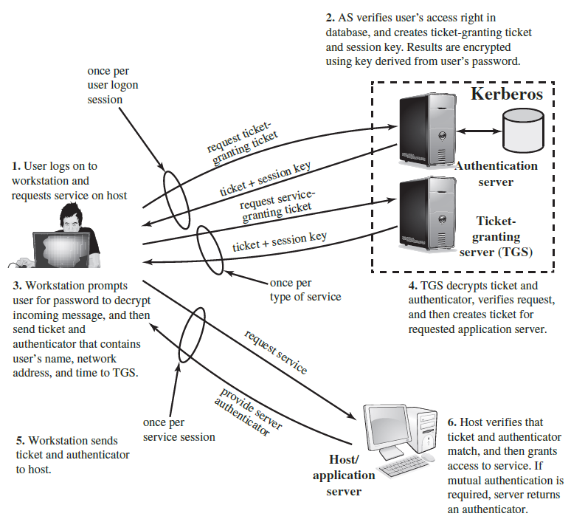
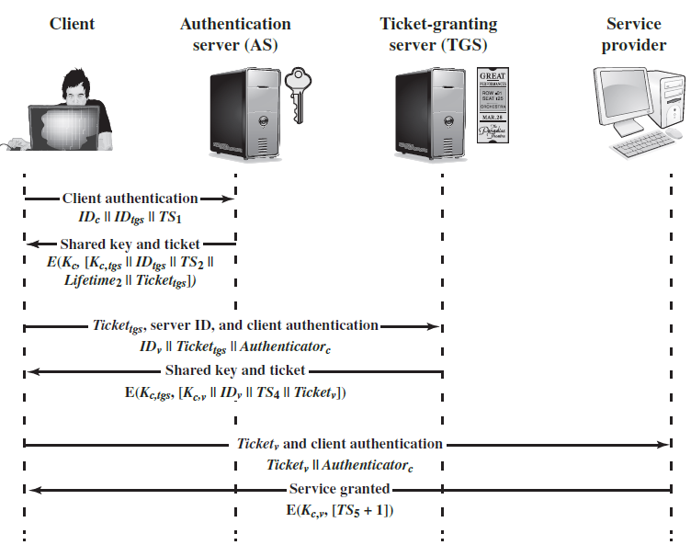
Kerberos Version4

Slide 37
Kerberos Realm
Kerberos environment
Consist of Kerberos server, clients, and application servers
Referred to Kerberos realm
Kerberos realm
Set of managed nodes sharing same Kerberos database
Requirements
Kerberos server must have user ID and hashed passwords of all users in its database
Kerberos server must share a secret key with each server
Kerberos server in each interoperating realm shares secret key with server in other realm
Case of supporting inter-realm authentication

Slide 38
Why Inter-realm Authentication is needed?
Networks of clients and servers under different administrative organizations
Constitute different realms
Case for requiring inter-realm authentication
User in one realm want access to servers in other realms
Servers want to provide service to users from other realms
So, scheme requires
Kerberos server in one realm trust Kerberos server in the other realm

Slide 39
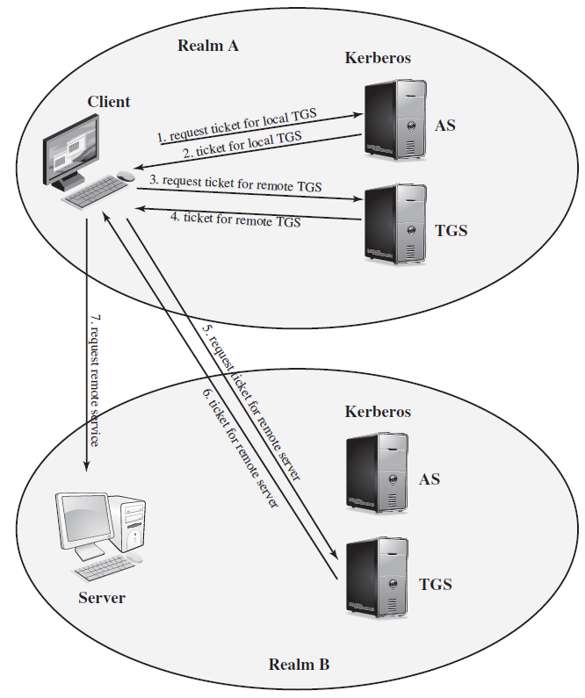
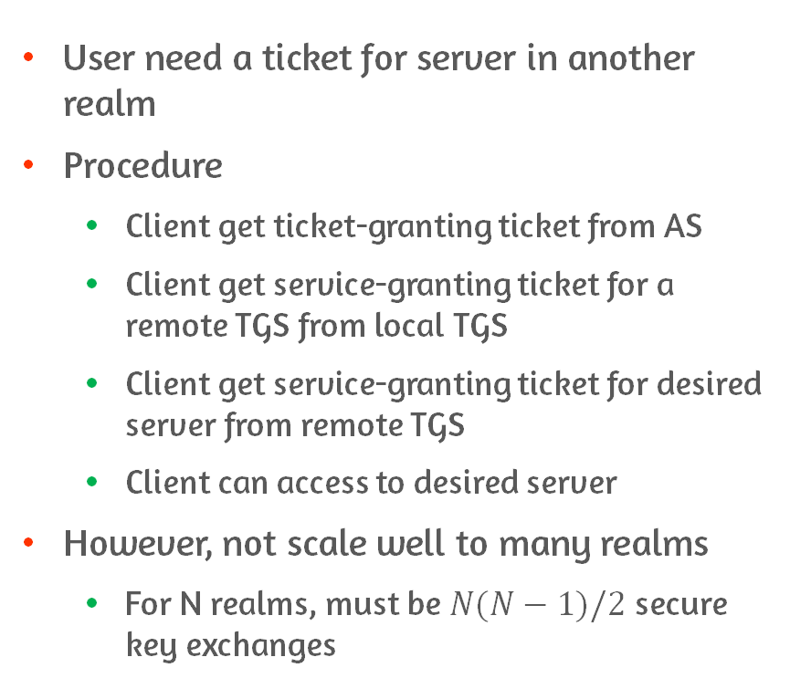
How to?
User need a ticket for server in another realm
Procedure
Client get ticket-granting ticket from AS
Client get service-granting ticket for a remote TGS from local TGS
Client get service-granting ticket for desired server from remote TGS
Client can access to desired server
However, not scale well to many realms
For N realms, must be $N(N−1)/2$ secure key exchanges

Slide 40
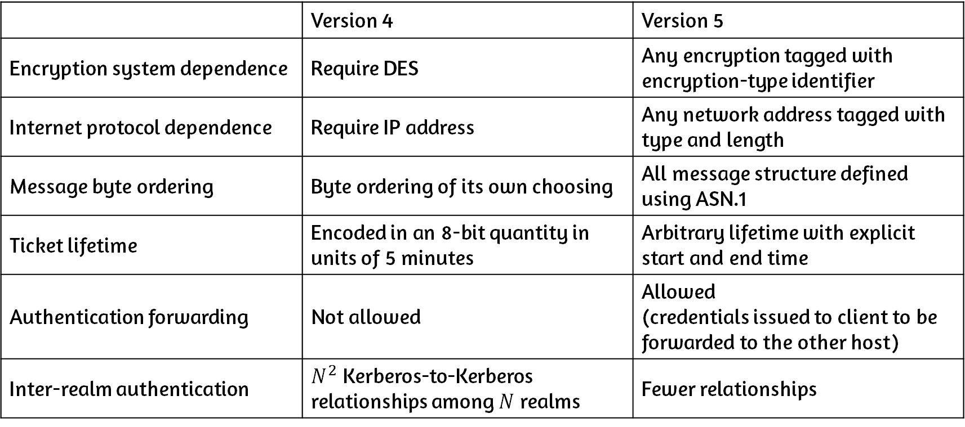
Environmental Difference Between Version 4 and 5
 | Version 4 | Version 5
Encryption system dependence | Require DES | Any encryption tagged with encryption-type identifier
Internet protocol dependence | Require IP address | Any network address tagged with type and length
Message byte ordering | Byte ordering of its own choosing | All message structure defined using ASN.1
Ticket lifetime | Encoded in an 8-bit quantity in units of 5 minutes | Arbitrary lifetime with explicit start and end time
Authentication forwarding | Not allowed | Allowed (credentials issued to client to be forwarded to the other host)
Inter-realm authentication | $N^{2}$ Kerberos-to-Kerberos relationships among $N$ realms | Fewer relationships
Notes:
Authentication forwarding
Client에 발급된 credential을 다른 host에게 forward & 다른 client에 의해 사용됨
-> client가 서버에 접근 가능하게 하고, 그 서버가 다른 서버에 client를 대신해서 접근할 수 있도록 함
e.g., client가 print server에 request를 넣음. File server로부터 client file에 접근하는데, 이 때 사용자의 credential 그대로 이용

Slide 41
Technical Difference Between Version 4 and 5
 | Version 4 | Version 5
Double encryption | Tickets are encrypted twice (secret key of server and known to client) | Second encryption is not necessary So, eliminate 2nd encryption
Propagating Cipher Block Changing (PCBC) encryption | Non-standard mode of DES | Standard CBC mode Checksum or hash code is attached to message
Session keys | Same ticket(includes session key) is used repeatedly to gain service : risk of replaying | Can negotiate sub-session key and used only for one connection
Password attacks | Vulnerable to password attack : key based on client’s password → capture message and attempt decrypting using various password | Pre-authentication to make password attacks more difficult
Notes:
PCBC encryption to provide integrity

Slide 42
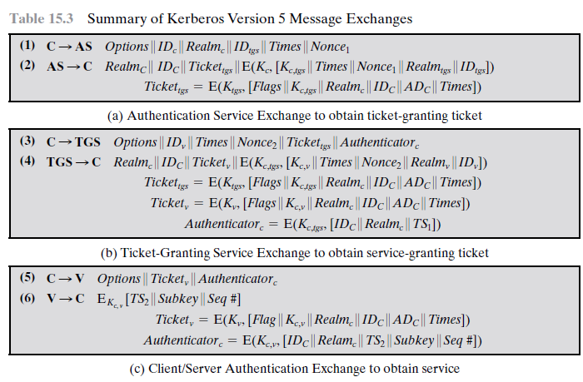
Authentication Service Exchange #1
(1) request for ticket-granting ticket
As before, (1) includes ID of user and TGS
Added elements
Realm: realm of user
Options: request flag to be set in ticket
Times: request time setting in ticket
from: start time of ticket
till: expiration time of ticket
rtime: requested renew-till time
Nonce
Repeated in message (2)
To assure (2) is not replayed

Slide 43
Authentication Service Exchange #2
(2) returns ticket-granting ticket
Includes session key, and times, nonce, realm, ID of TGS from message(1)
Ticket includes session key, identifying information for client, requested time value and flags

Slide 44
Ticket-granting Exchange
(3) additionally includes requested times and options for ticket and Nonce in ver. 5
(4) has same structure as (2)
Return ticket + information needed by client

Slide 45
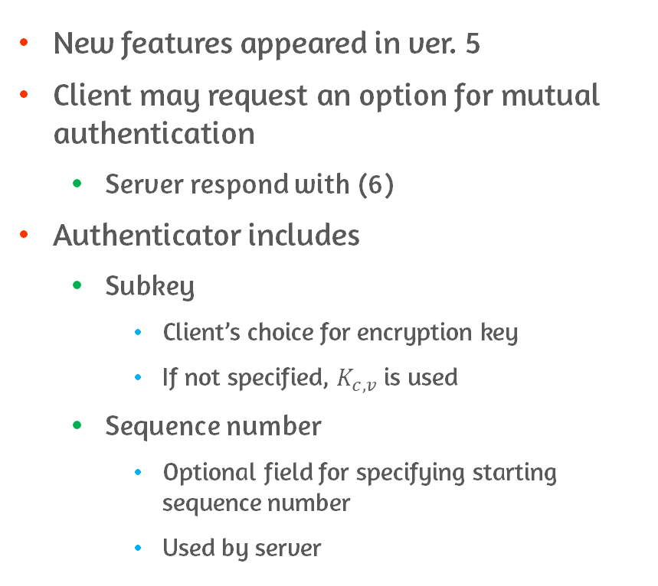
Client/server Authentication Exchange
New features appeared in ver. 5
Client may request an option for mutual authentication
Server respond with (6)
Authenticator includes
Subkey
Client’s choice for encryption key
If not specified, $K_{c, v}$ is used
Sequence number
Optional field for specifying starting sequence number
Used by server
Notes:
Timestamp가 더 이상 필요 없음

Slide 46
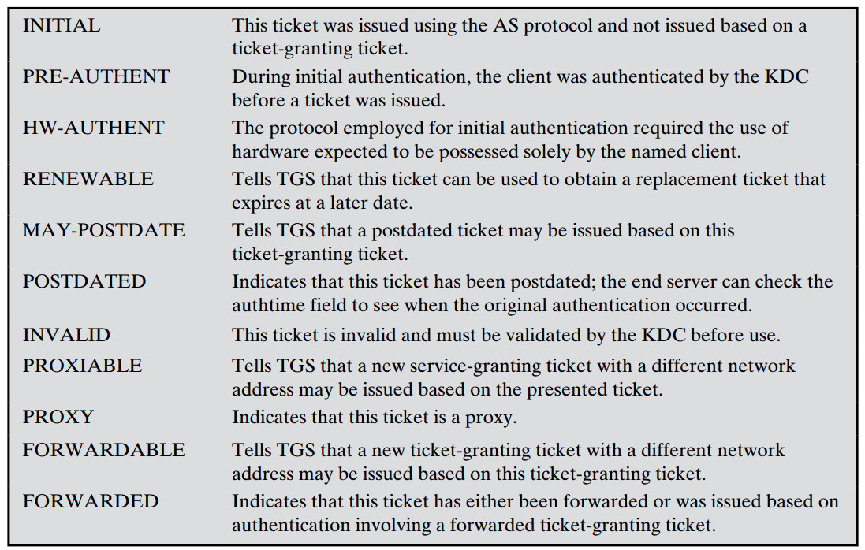
Ticket Flags
INITIAL
Ticket is issued by AS
Get the service ticket directly from AS
PRE/HW-AUTHENT
Previously authenticated or authenticated by H/W
RENEWABLE
Ticket that can be renewed
Indicates the lot of ticket usage

Slide 47
15.4 Remote User Authentication Using Asymmetric Encryption

Slide 48
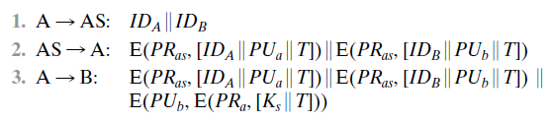
Session Key Distribution With Timestamp
Assumption
Each of two parties in possession of KDC’s public key
Central system: authentication server(AS)
Not responsible for secret key distribution
Provide public-key certificate
Session key is chosen and encrypted by A
No risk of exposure by AS
Timestamp protect replay of compromised key
Problem: requirement of synchronized clock

Slide 49
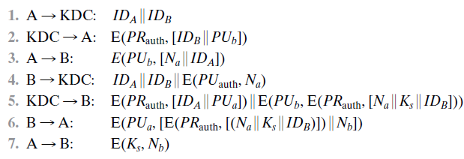
Advanced Protocol Using Nonce #1
A informs KDC of desire to establish secure connection with A
KDC returns B’s certificate to A
A informs B of desire to communicate and send nonce
B ask KDC for A’s certificate and session key
KDC can stamp session key with nonce

Slide 50
Advanced Protocol Using Nonce #2
KDC return A’s certificate and information [nonce, session key, B’s ID] to B
Session key is generated by KDC and tied to nonce
A assure session key is fresh
Binding nonce and session key
Information is relayed to A with B’s nonce
A get session key, and encrypt B’s nonce with session key

Slide 51
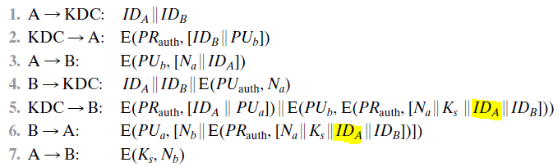
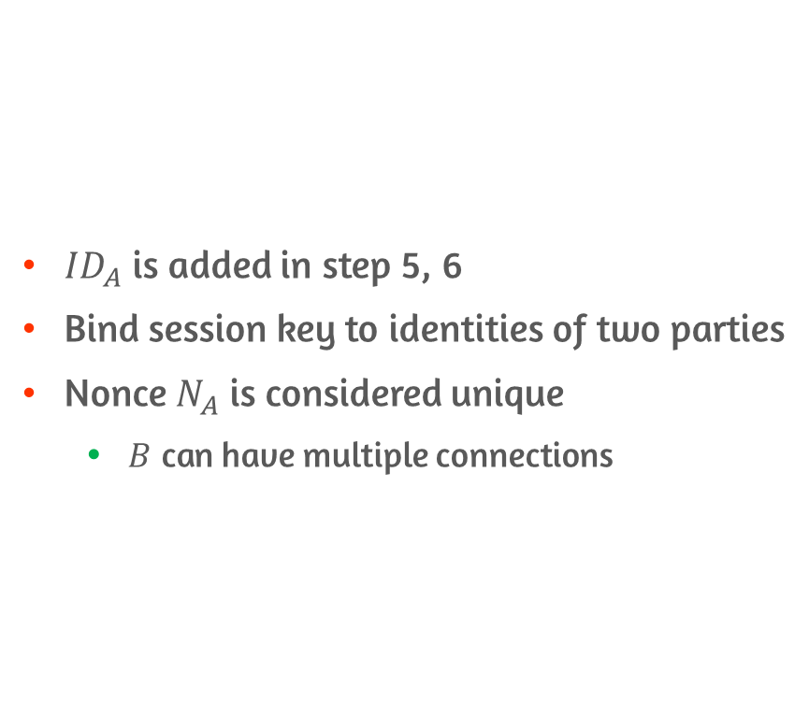
Revised Protocol to Be Secure
${ID}_{A}$ is added in step 5, 6
Bind session key to identities of two parties
Nonce $N_{A}$ is considered unique
$B$ can have multiple connections

Slide 52
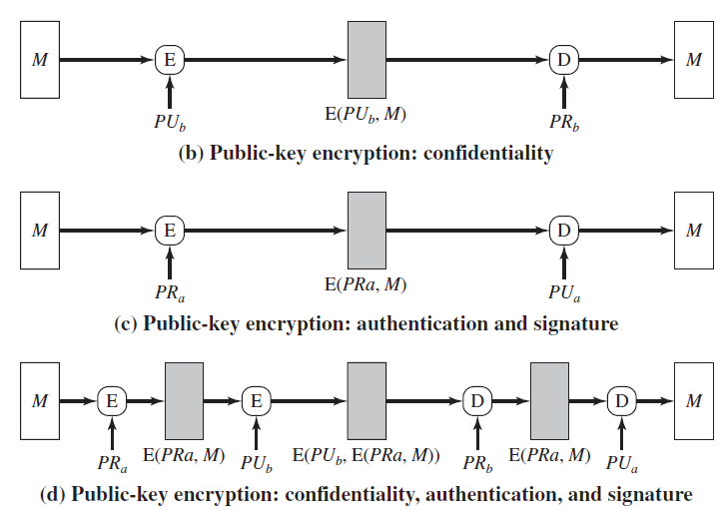
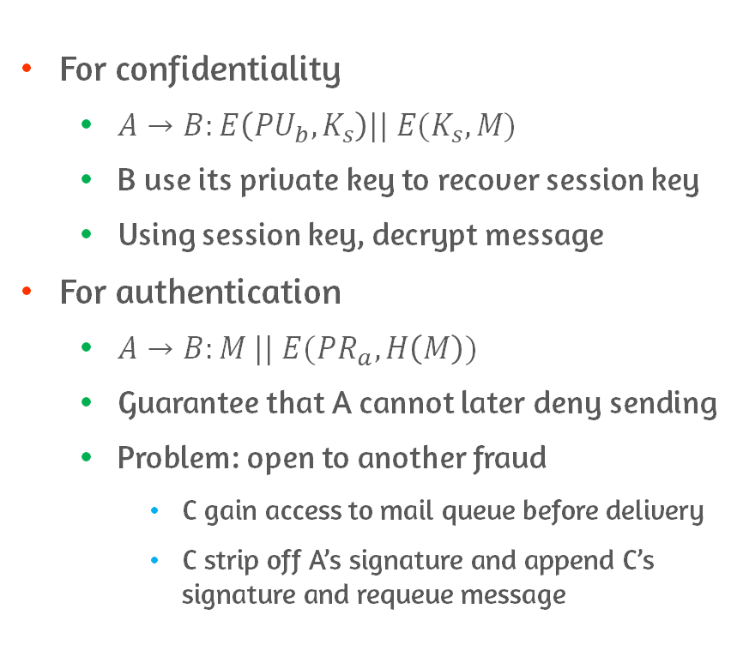
Public-key Encryption Approaches Suited to E-mail
For confidentiality
$A→B:E\left({PU}_{b}, K_{s}\right)|| E(K_{s}, M)$
B use its private key to recover session key
Using session key, decrypt message
For authentication
$A→B:M || E({PR}_{a}, H\left(M\right))$
Guarantee that A cannot later deny sending
Problem: open to another fraud
C gain access to mail queue before delivery
C strip off A’s signature and append C’s signature and requeue message

Slide 53
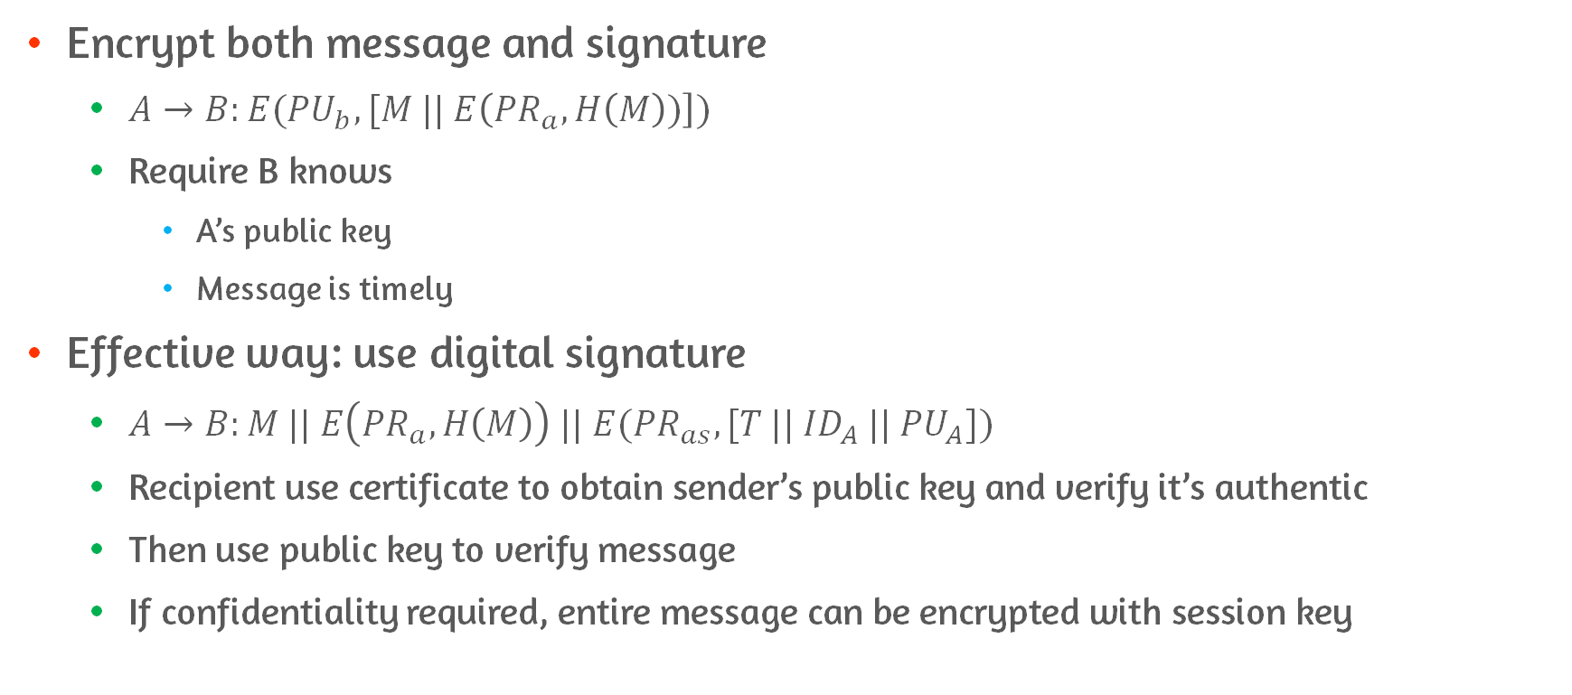
Counter to Fraud Signature
Encrypt both message and signature
$A→B:E({PU}_{b}, [M || E\left({PR}_{a}, H\left(M\right))\right])$
Require B knows
A’s public key
Message is timely
Effective way: use digital signature
$A→B:M || E\left({PR}_{a}, H\left(M\right)\right) || E({PR}_{as}, [T || {ID}_{A} || {PU}_{A}])$
Recipient use certificate to obtain sender’s public key and verify it’s authentic
Then use public key to verify message
If confidentiality required, entire message can be encrypted with session key

Slide 54
15.5 Federated Identity Management

Slide 55
Federated Identity Management
Federated identity management
Deal with use of common identity management scheme
Across multiple enterprises, applications and supporting users
Identity management = centralized, automated approach
For providing enterprise-wide access to resources by authorized individuals
Role
Define identity for each user
Associate attributes with identity
Enforce a means by which user can verify identity
Central concept of identity management system is use of Single-Sign-On(SSO)

Slide 56
Typical Services Provided by Federated Identity Management
Service | Description
Point of contacts | User corresponds to the user name provided
SSO protocol service | Provide vendor-neutral security token service for supporting SSO to federated service
Trust services | For trust relationship-based federation is represented by combination of security token(for exchange information) and identity mapping rules applied to information
Key services | Management of keys and certificates
Identity services | Provide interface to local data stores(e.g., user registries and databases)
Authorization | Grant access to specific service or resource based on authentication
Provisioning | Create account for user, enrollment of user in accounts, establishment of access rights or credentials
Management | Service related to runtime configuration and deployment
Notes:
Authentication vs. Authorization?
Runtime Configurator?
Provisioning?

Slide 57
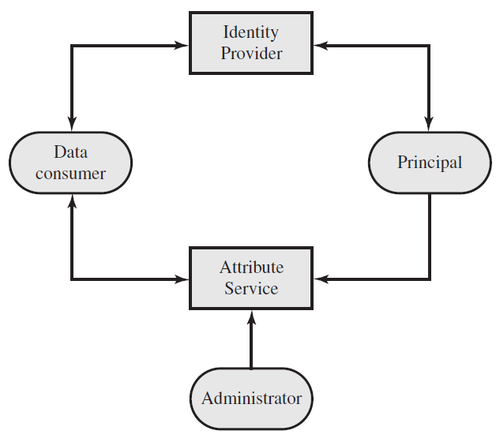
Generic Identity Management Architecture #1
Principal is identity holder
Seek access to resources and services on network
Principal authenticate themselves to Identity Provider
Associate authentication information with principal, attributes or identifiers
Attribute service manage creation and maintenance of attributes
Attributes: identifier, authentication information(password, biometric), etc.
Administrator assign attributes to user
Role, access permission, etc.
Notes:
두 attribute가 다른가?

Slide 58
Generic Identity Management Architecture #2
Data consumer obtain and use data
Data is maintained and provided by identity and attribute providers
For supporting authorization decisions and collecting audit information
E.g., database server
Need client’s credentials to know what access to provide to that client
Notes:
두 attribute가 다른가?

Slide 59
Identity Federation
Extension of identity management to multiple security domains
Goal: Provide sharing digital identities
User can be authenticated a single time
Then, access applications and resources across multiple domains
Must form federation based on agreed standards a mutual levels of trust to securely share digital identities
Federated identity management enable portability of identities, identity attributes, and entitlement across multiple enterprises
In interoperable federated identity schemes, employee can use single sign on to access services across federation

Slide 60
Capabilities of Federated Identity Management
Standardized means of representing attributes
E.g., attributes: account numbers, physical location and file ownership
Identity Mapping
Different security domains represent identities and attributes differently
Information associated with individual in one domain may be more than is necessary in another domain
Map identities and attributes of user in one domain to requirements of another domain

Slide 61
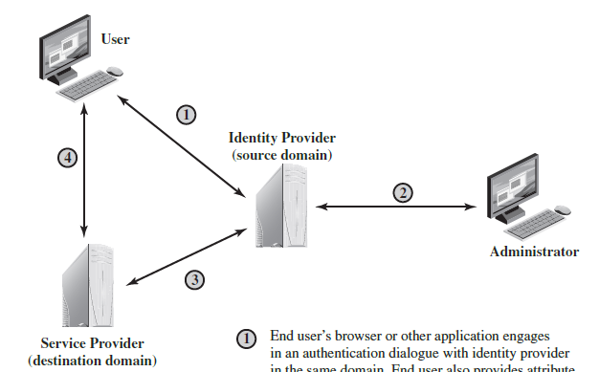
Flow in Generic Federated Identity Management
Identity provider acquire information from user and administrator
Service provider obtain and use data maintained and provided by identity provider
Support authorization decision and collect audit information
E.g., database server or file server that needs a client’s credentials
To know what access to provide
Notes:
Source domain?

Slide 62
Standard for Identity Exchange across Different Domain
Organizations issue security tickets for users
Define ticket in terms of content and format
Standards
Extensible Markup Language(XML)
Markup language that uses sets of embedded tags to characterize text elements
Simple Object Access Protocol(SOAP)
Request services from one another with XML-based requests
WS-Security
Set of SOAP extensions for implementing message integrity and confidentiality in web service
Security Assertion Markup Language
XML-based language for exchange of security information

Slide 63
Conclusions
Understand distinction between identification and verification
Present overview of techniques for remote user authentication using symmetric encryption
Presentation of Kerberos
Explain differences between version 4 and 5 of Kerberos
Describe the use of Kerberos in multiple realms
Present overview of techniques for remote user authentication using asymmetric encryption
Understand the need for a federated identity management system

